Slide 2
Decision making structures

Slide 3
Decision-making Statements
JavaScript supports four decision-making statements, which are as follows:
^{if}
^{if-else}
^{if-else if}
^{switch}

Slide 4
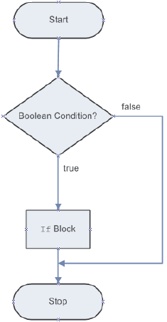
if Statement 1-2
Executes a block of statements based on a logical Boolean condition.
If this condition is true, the block following the if statement is executed.
If the condition is false, the block after the if statement is not executed and the immediate statement after the block is executed.

Slide 5
if-else Statement 1-2
if statement specifies a block of statement to be executed when the condition in the if statement is true.
Sometimes it is required to define a block of statements to be executed when a condition is evaluated to false.
if-else statement begins with the if block, which is followed by the else block.
The else block begins with the else keyword followed by a block of statements to be executed upon the false condition.

Slide 6
Nested if Statement 1-2
Comprises of multiple if statements within an if statement.
Flow of the nested-if statements starts with the if statement, which is referred to as the outer if statement.
Outer if statement consists of multiple if statements, which are referred to as the inner if statements.
Inner if statements are executed only if the condition in the outer if statement is true.
Each of the inner if statements is executed but, only if the condition in its previous inner if statement is true.

Slide 7
Nested if Statement 2-2
The Code Snippet demonstrates the use of nested if statement.
^{<SCRIPT>}
var username = prompt(‘Enter Username:’);
var password = prompt(‘Enter Password:’);
if (username != “” && password != “”)
{
if (username == “admin” && password == “admin123”)
{
^{alert(‘Login Successful’);}
}
^{else}
{
^{alert (‘Login Failed’);}
}
}
^{</SCRIPT>}

Slide 8
switch-case Statement 1-2
A program becomes quite difficult to understand when there are multiple if statements.
To simplify coding and to avoid using multiple if statements, switch-case statement can be used.
switch-case statement allows comparing a variable or expression with multiple values.

Slide 9
switch-case Statement 2-2
The Code Snippet demonstrates the use of switch-case statement.
^{<SCRIPT>}
var designation = prompt(‘Enter designation:’);
^{switch (designation)}
{
^{case ‘Manager’:}
^{alert (‘Salary: $21000’);}
^{break;}
^{case ‘Developer’:}
^{alert (‘Salary: $16000’);}
^{break;}
^{default:}
alert (‘Enter proper designation.’);
^{break;}
}
^{</SCRIPT>}

Slide 10

JavaScript While Loop
Loops can execute a block of code as long as a specified condition is true.
The While Loop
The while loop loops through a block of code as long as a specified condition is true.
Syntax

Slide 11

The Do/While Loop
The do/while loop is a variant of the while loop. This loop will execute the code block once, before checking if the condition is true, then it will repeat the loop as long as the condition is true.
Syntax

Slide 12

JavaScript For Loop
The For Loop
The for loop is often the tool you will use when you want to create a loop.
The for loop has the following syntax:

